Slide 1
Bài 3
Port Security, DHCP Snooping, ACL

Slide 2
Outline
Port security
DHCP snooping
ACL

Slide 3
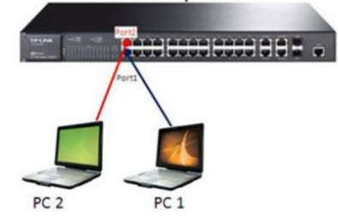
1. Port Security
Secured ports restrict a port to a user-defined group of stations.

Slide 4
Port Security
  Interface :Port to secure.
  Security :Enable port security on the port.
  Trap :Issue a trap when an address-security violation occurs.
  Shutdown Port :Disable the port when an address-security violation occurs.

Slide 5
Port Security
Commands:
SW(config)#interface Fa0/1
SW(config-if)#switchport mode access
SW(config-if)#switchport port-security
SW(config-if)#switchport port-security maximum 1
SW(config-if)#switchport port-security mac-address H.H.H | Sticky
SW(config-if)#switchport port-security violation shutdown
SW(config)#errdisable detect cause all
SW(config)#errdisable recovery cause all
SW(config)#errdisable recovery interval 30

Slide 6
Lab: Port Security

Slide 7
2. DHCP Snooping
DHCP Snooping is a layer 2 security technology incorporated into the operating system of a capable network switch that drops DHCP traffic determined to be unacceptable.
DHCP Snooping prevents unauthorized (rogue) DHCP servers offering IP addresses to DHCP clients.

Slide 8
DHCP Snooping
To prevent a Man-in-the-middle attack on our network
Fake DHCP Servers can respond to DHCPDISCOVER messages before the real server has time to respond.
DHCP Snooping allows switches on the network to trust the port a DHCP server is connected to (this could be a trunk) and not trust the other ports.

Slide 9
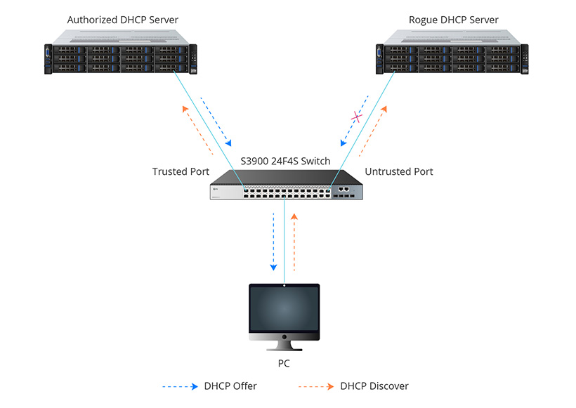
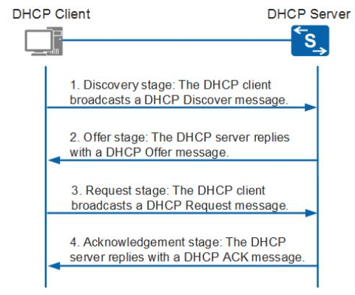
How DHCP Snooping Works?

Slide 10
DHCP Snooping

Slide 11
DHCP Snooping

Slide 12
DHCP Snooping
Commands:
SW(config)#ip dhcp snooping
SW(config)#ip dhcp snooping vlan 1-100
SW(config)#no ip dhcp snooping information option
SW(config)#interface Fa0/1 → connect to real DHCP server
SW(config-if)#ip dhcp snooping trust
Verify the configuration:
SW#show ip dhcp snooping

Slide 13
3. Access Control List - ACL

Slide 14
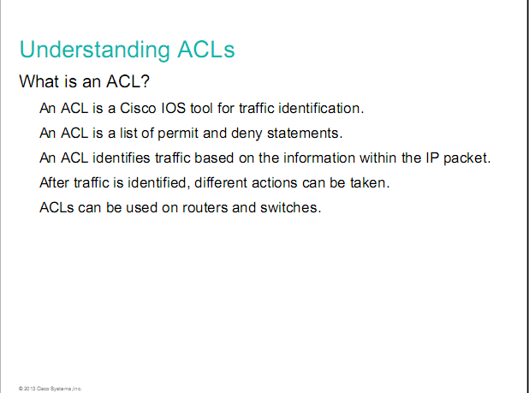

Slide 15
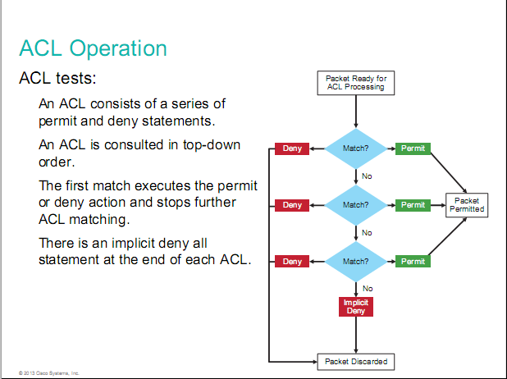

Slide 16
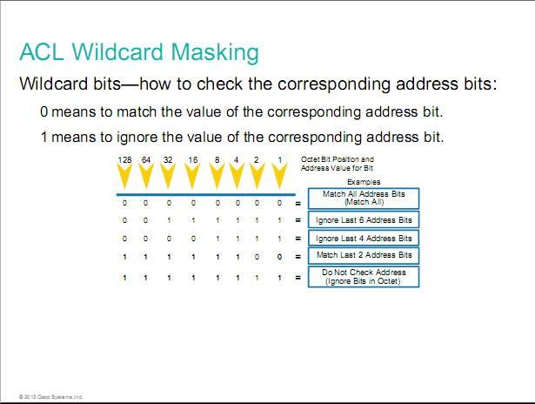

Slide 17
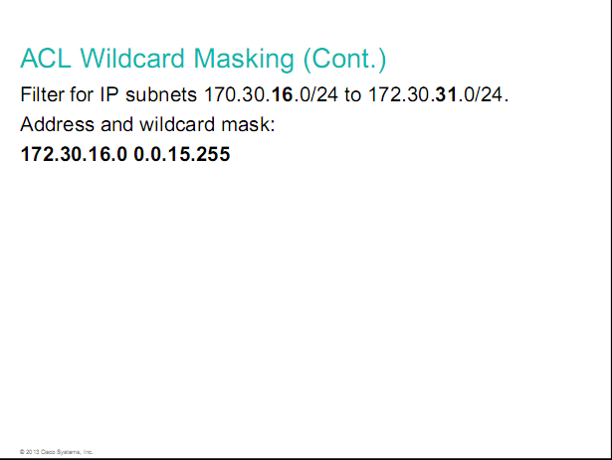

Slide 18
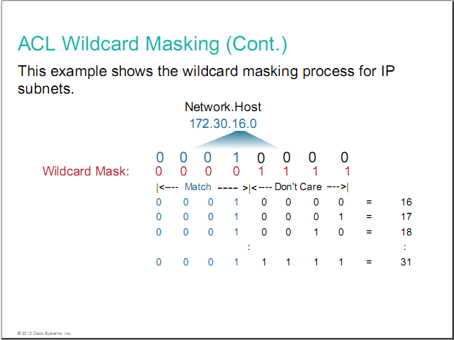

Slide 19
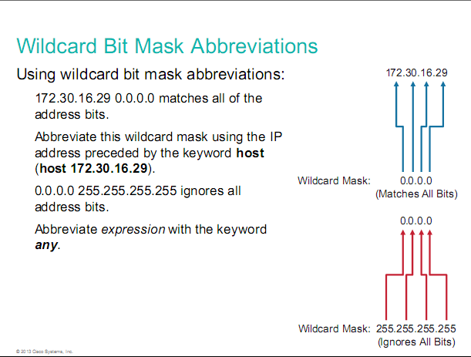

Slide 20
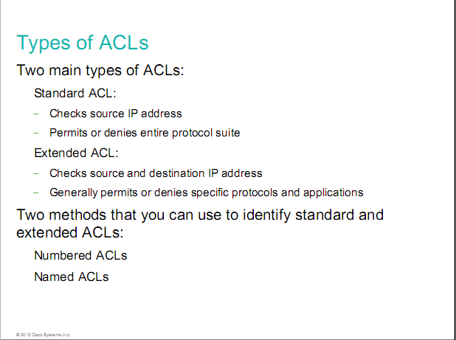

Slide 21
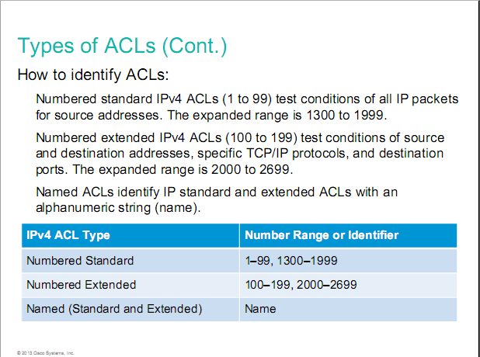

Slide 22
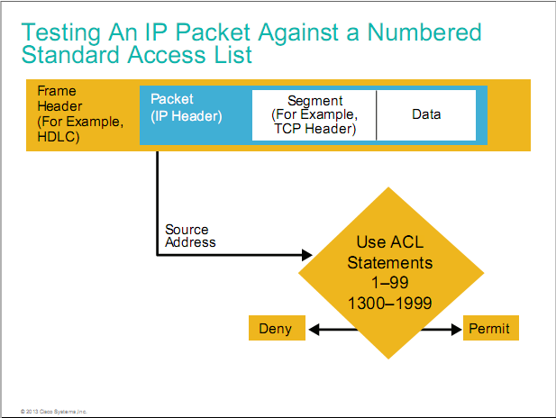

Slide 23
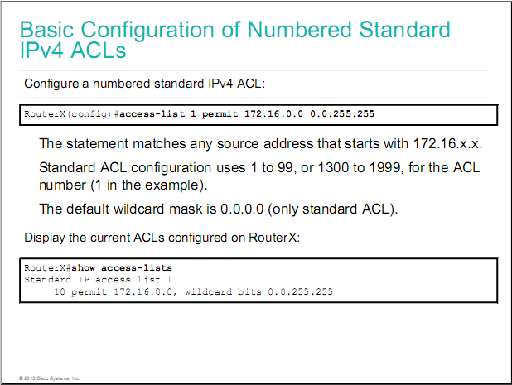

Slide 24
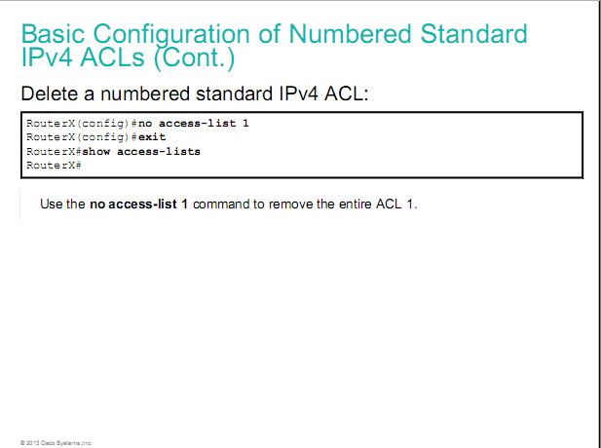

Slide 25


Slide 26
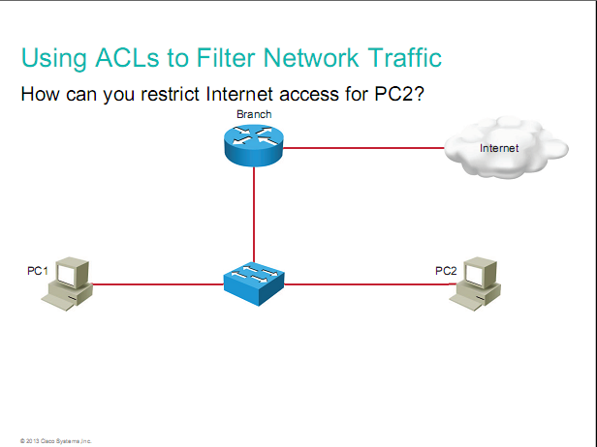

Slide 27
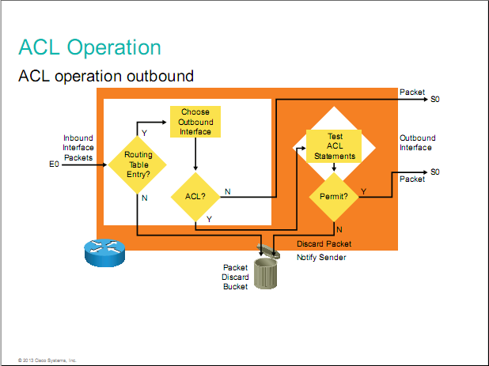

Slide 28
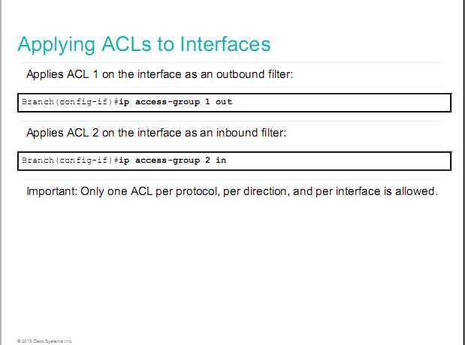

Slide 29
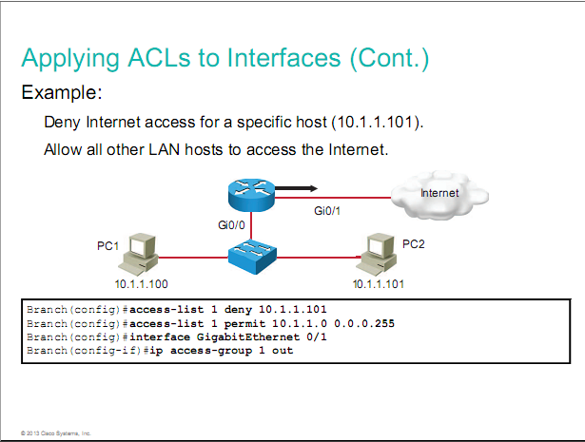

Slide 30
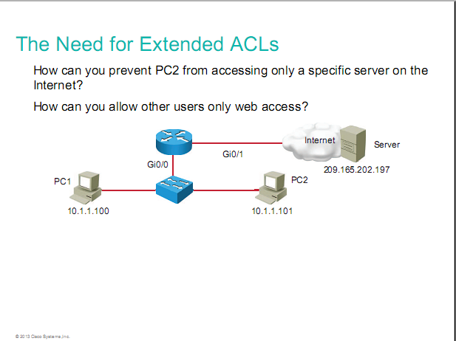

Slide 31
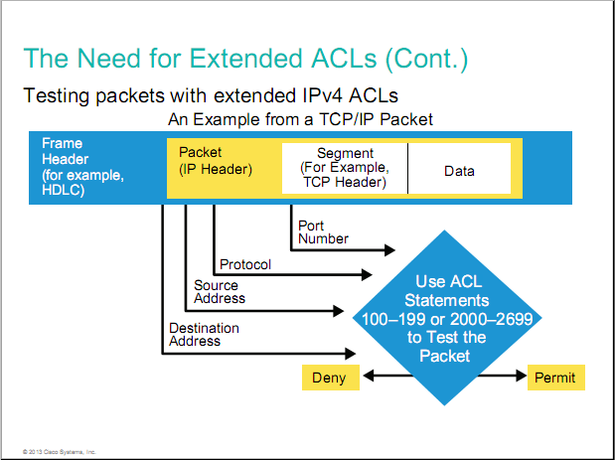

Slide 32
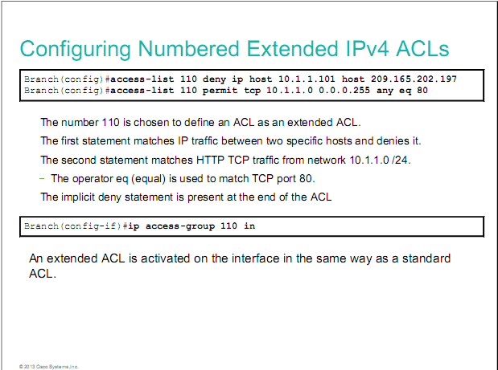

Slide 33
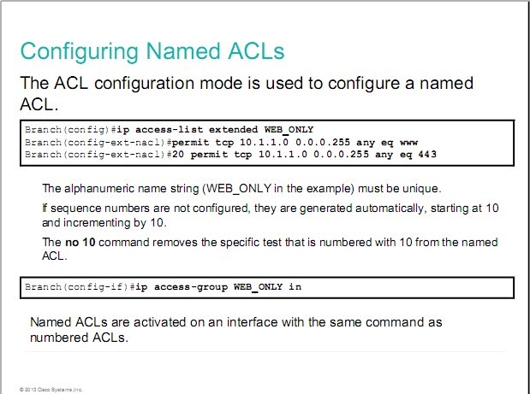

Slide 34
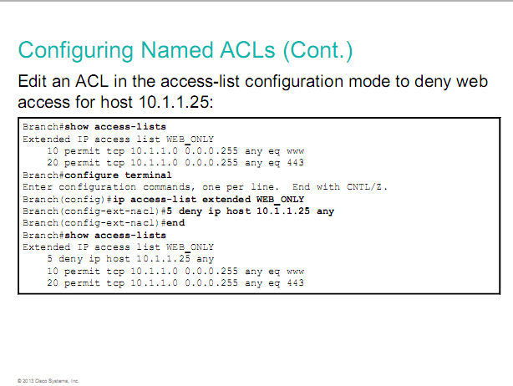

Slide 35
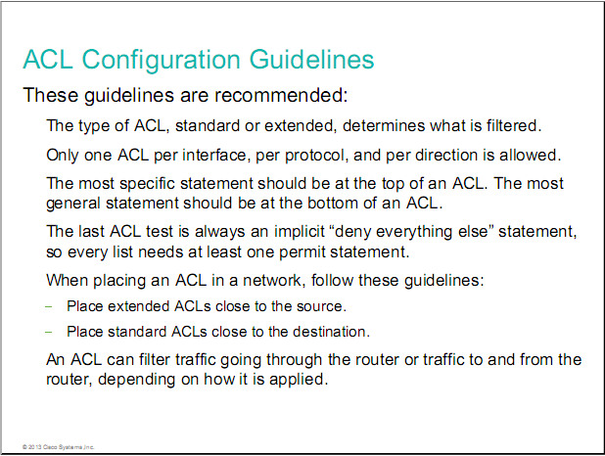

Slide 36
